Slide 1

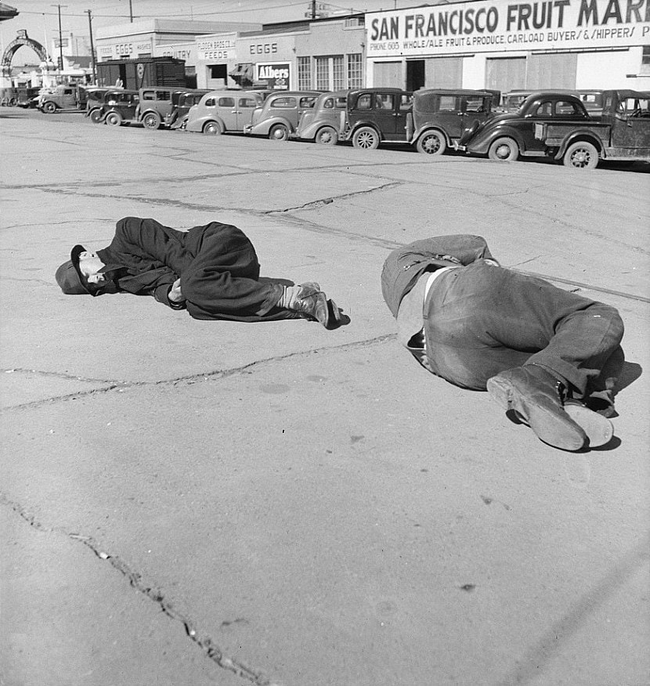
Rehousing the Unhoused in San Francisco, CA
Christopher Singer
General Assembly, DAIR-320

Slide 2
01
Background
02
Homeless Statistics
Table of contents
03
Housing Statistics
04
Limitations
05
Recommendations
What is homelessness?
Country and Point-In-Time (PIT) Counts
Housing Inventory Counts (HIC)
Limitations of this project and rehousing
What are my recommendations?

Slide 3
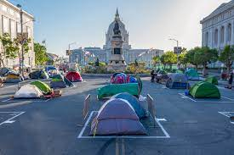
01
Background

Slide 4
What is Homelessness?
01
02
03
Inadequate shelter
Diverse Causes
Lack of access to basic resources

Slide 5

02
Homeless Statistics
Country data and San Francisco “Point-In-Time” Counts

Slide 6
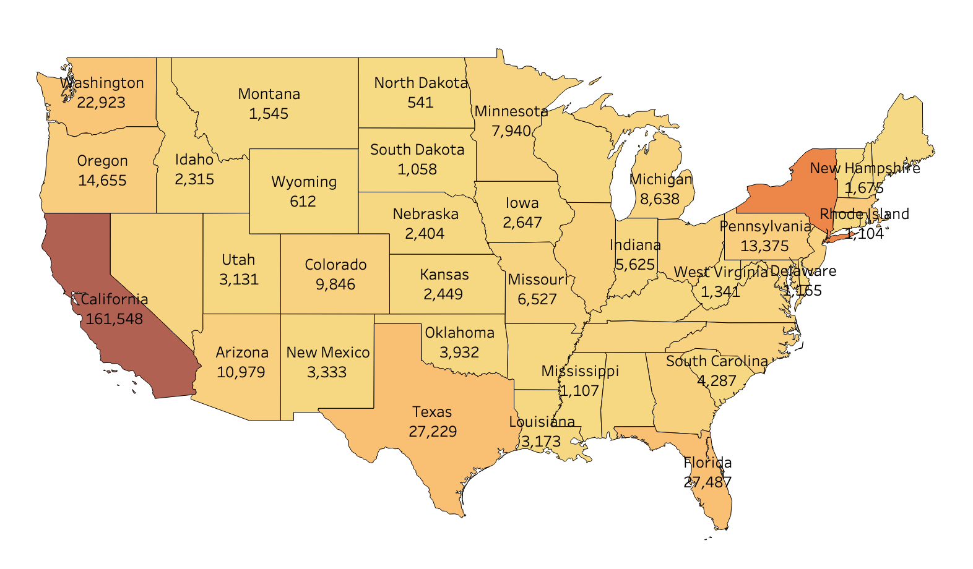
Map of the homeless population in the US
Estimated 91,259 unhoused individuals in New York
*There are an estimated 569,334 unhoused individuals in the United States
Source: World Population Review (2023)

Slide 7
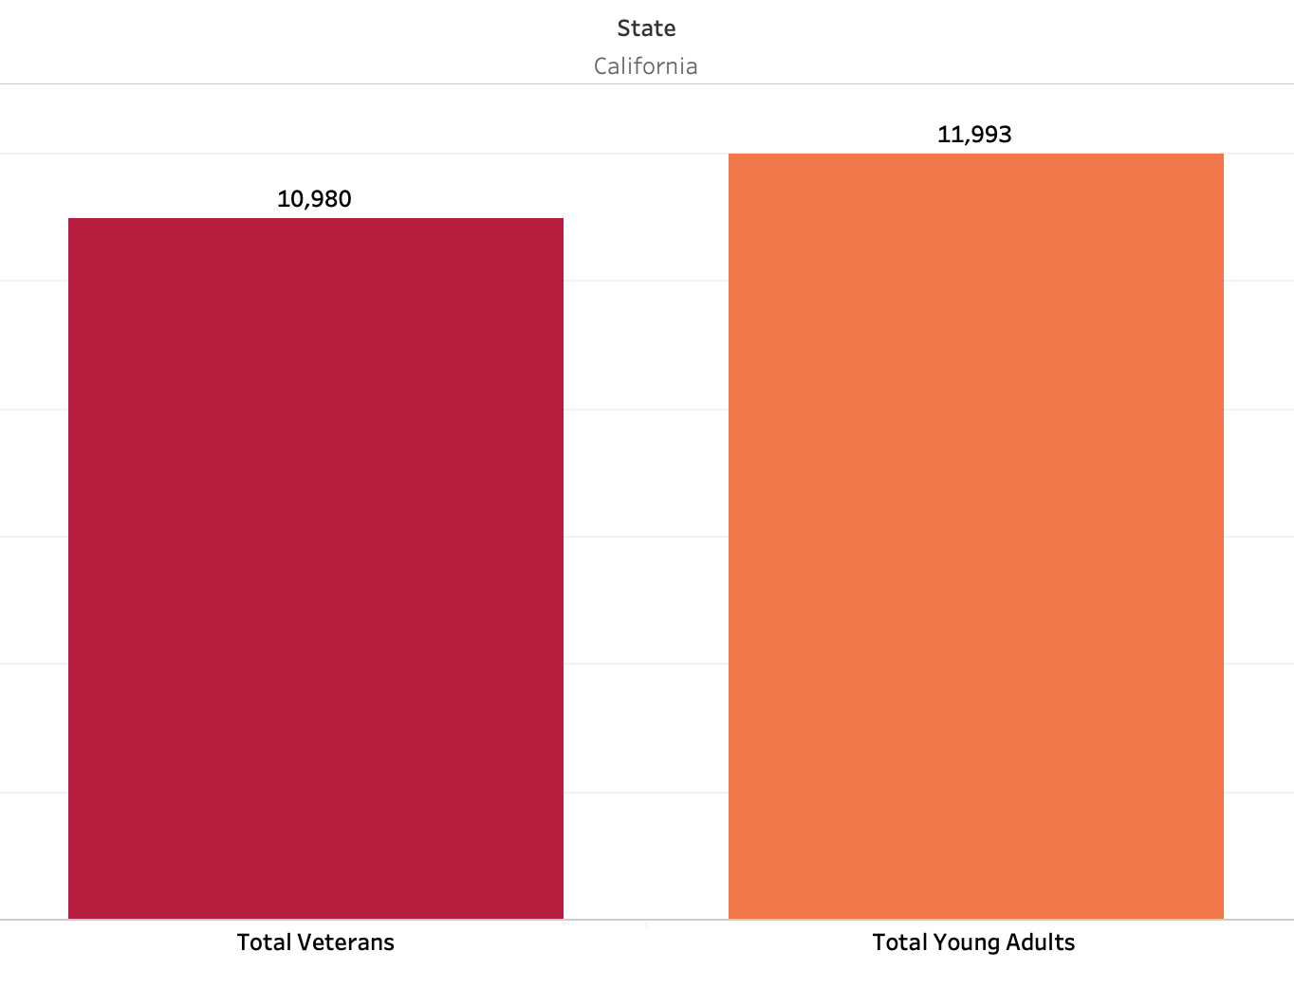
Specific Category Count
Source: World Population Review (2023)

Slide 8
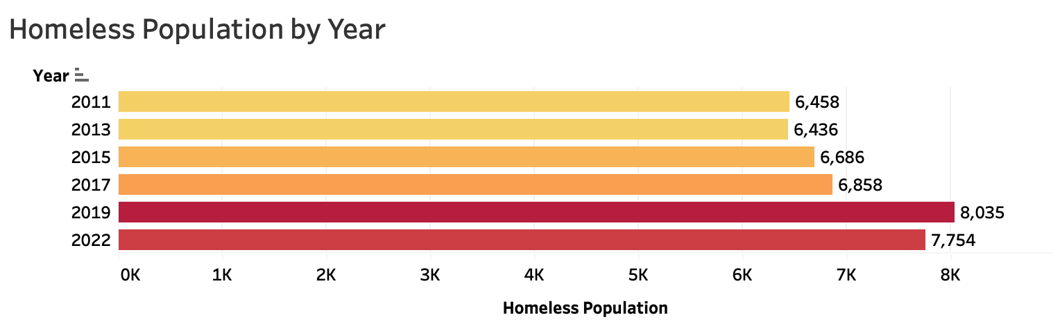
San Francisco Homeless Population Over Time
Source: HUD Point In Time Counts

Slide 9
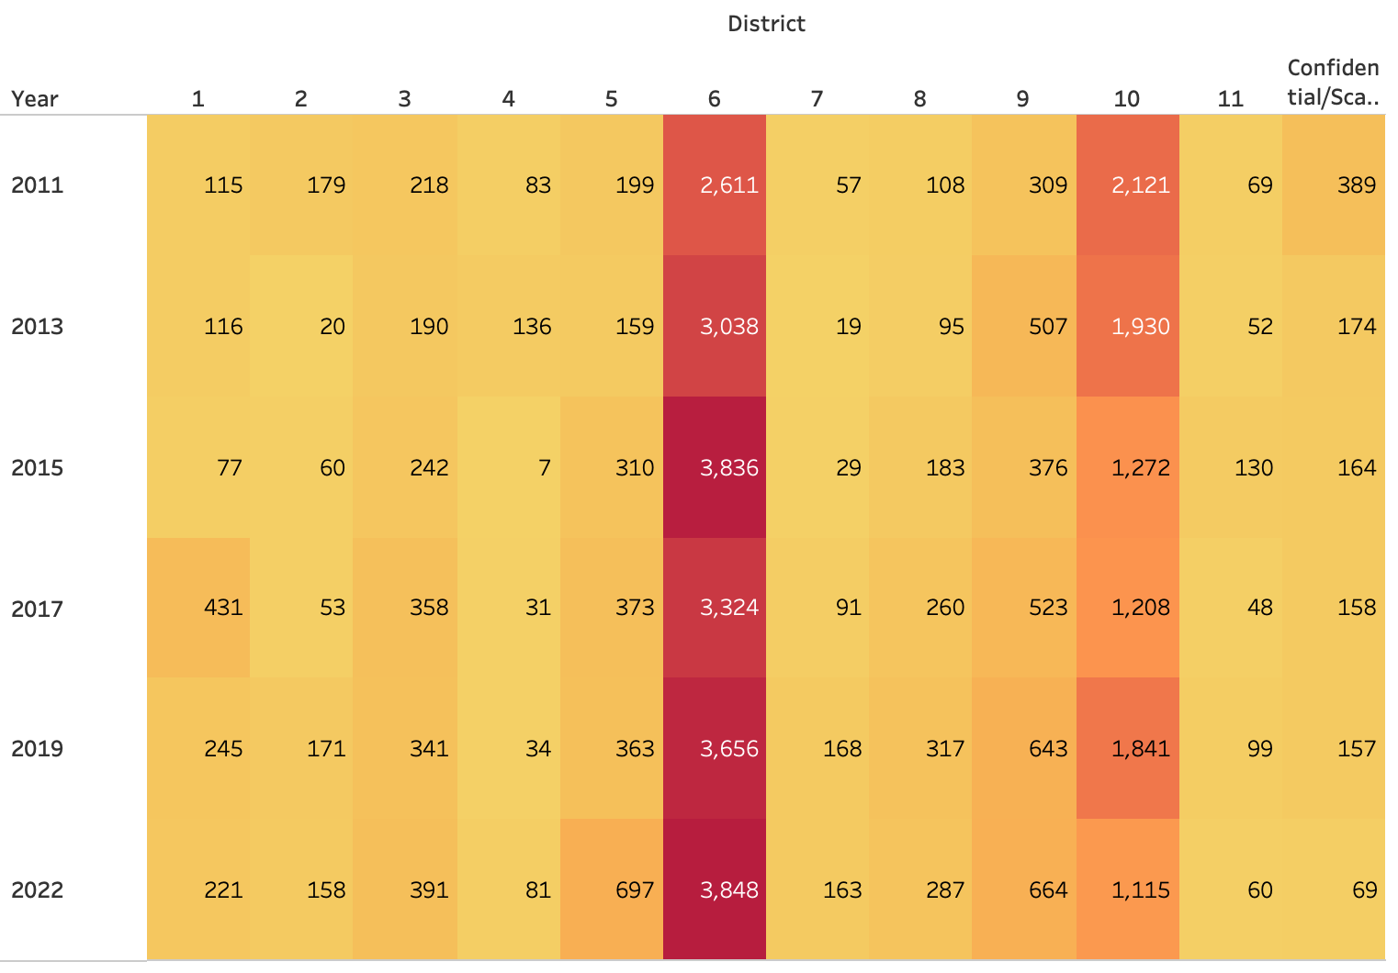
San Francisco Homeless Population by District
Source: HUD Point In Time Counts

Slide 10
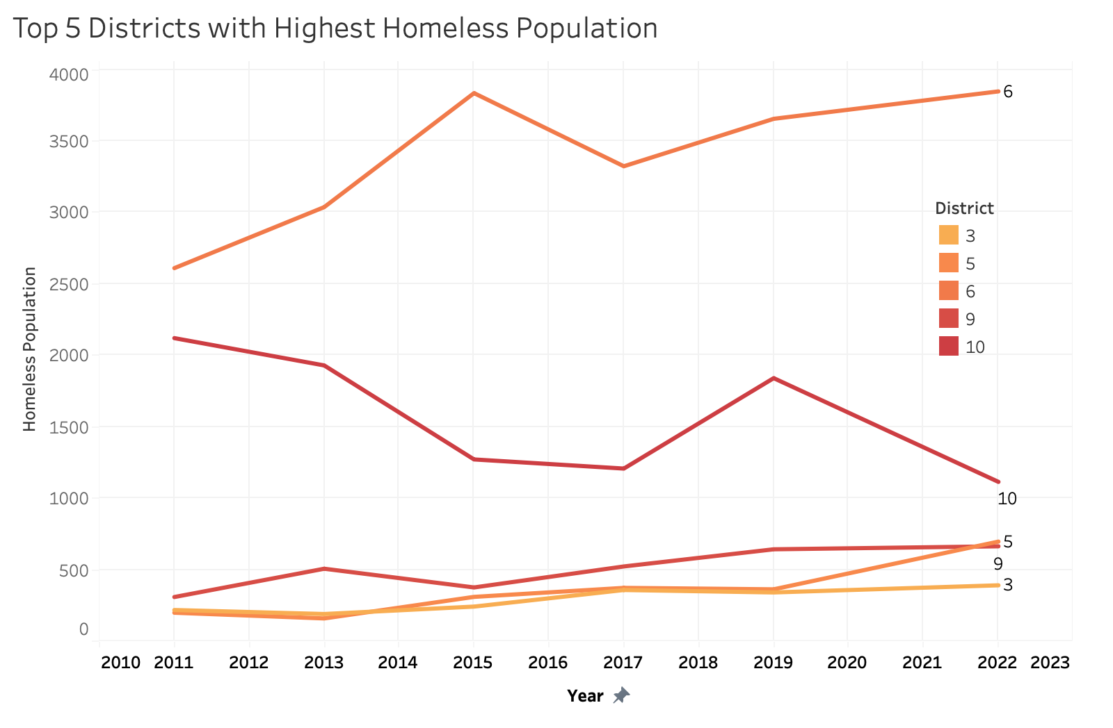
Homeless Population by District Synchronically
Source: HUD Point In Time Counts

Slide 11
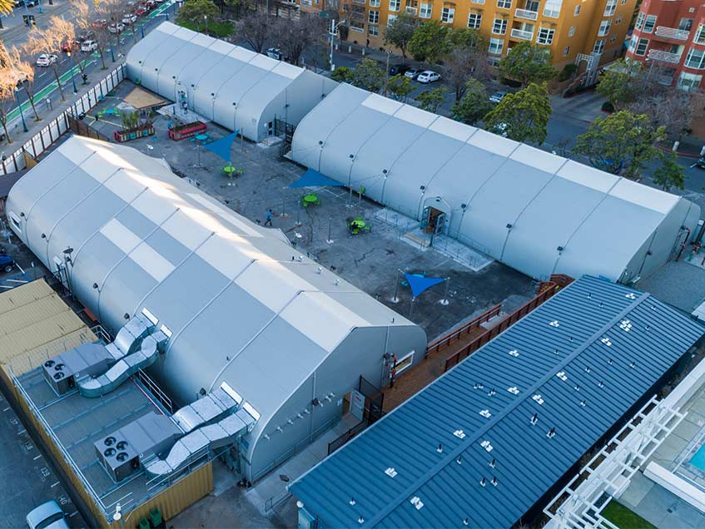
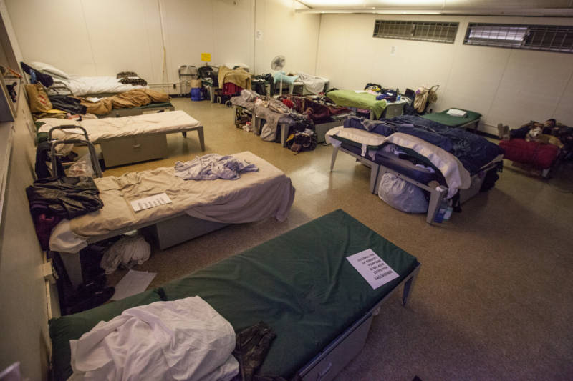
03
Housing Statistics
San Francisco Housing Inventory Counts

Slide 12
Source: HUD Continuum of Care Homeless Assistance Program Housing Inventory Count Report (2022)

Slide 13
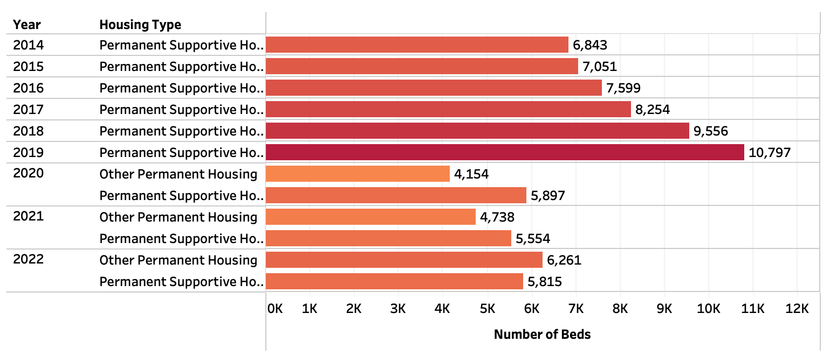
Number of Permanent Supportive Housing Beds in San Francisco

Slide 14

04
Limitations

Slide 15
01
Underreported Homeless Counts
02
Data Acquisition
03
Not all permanent housing has essential resources
Can not locate everyone
Does not take into account couch surfing or in an institution
Much of the data was privileged and could not be downloaded.
Bureaucratic hurdles
Ample showers, access to medical help, social workers
Can not force someone into housing

Slide 16

Recommendations
05

Slide 17

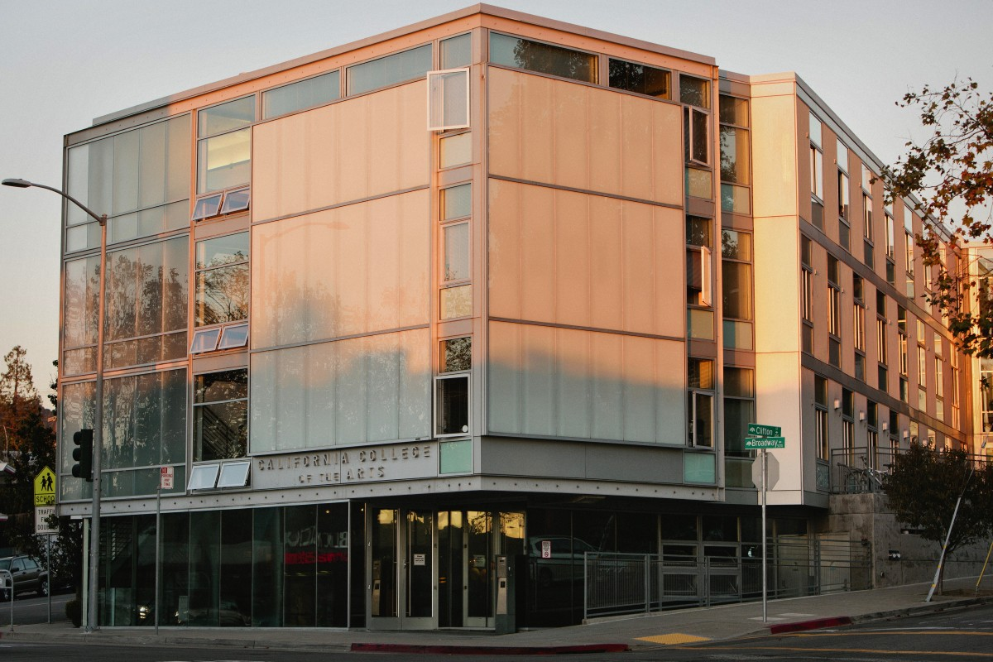
01
Funding for social workers
02
Increase funding for cities
03
Target Districts 6 and 10
04
Utilize current permanent housing
Additional Outreach, can better assist individuals in need
For additional essential resources and for hotel/office conversions
Highest unhoused populations
There are over 10,000 available adult-only beds slated for permanent housing and as of January 2022, 7,754 homeless individuals

Slide 18
Special Thanks!
Jeff Schonberg, PhD. Fellow, University of California, Berkeley & Lecturer, San Francisco State University
Heather Freinkel, Managing Attorney, Homeless Action Center
Corey Smith, Managing Director, Housing Action Coalition

